Slide 1
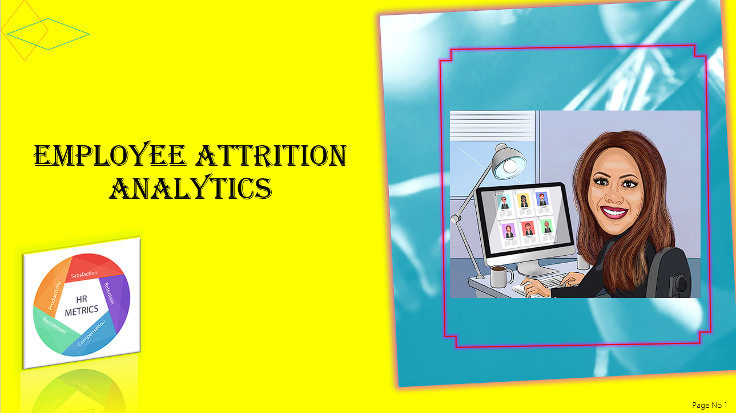

Slide 2




Project Analysis
Conclusion
Introduction
PROJECT
Recommendation
Data Overview
Data Insights
Exploratory Data Analysis
Power BI Analysis
Data Preprocessing
Page No 2

Slide 3
🌟 Business Problem Overview
🎯 Project Objective:
This project analyses employee attrition to identify key factors, predict potential departures, and develop strategies to retain high performers.
📌 Goals:
Identify Attrition Drivers:
🔍 Understand the primary factors influencing employee turnover.
Predict Future Attritions:
🔮 Forecast potential resignations and other forms of employee departures.
Develop Retention Strategies:
🧠 Create targeted recommendations to retain top talent and reduce turnover.
📚 Background:
Employee attrition, whether due to resignation or retirement, incurs significant costs related to recruitment and training. Effective management of attrition is essential for operational efficiency and minimizing these costs.
🛠️ Tools Utilized:
This project combines Python libraries (Numpy, Pandas, Seaborn, and Matplotlib.pyplot) with Power BI to process, visualize, and analyse data, providing actionable insights to tackle employee attrition effectively.
Page No 3

Slide 4
📊 Employee Attrition Data Overview
10. Current Status:
🔄 The current employment status of the employee (e.g., Active, Resigned, Secondment, New Joiner).
11. Termination Date:
🚪 The date when the employee was terminated or left the organization. If the value is missing, the employee is still active.
12. Total Available Hours:
⏰ The total number of hours the employee was available to work, including all scheduled work hours.
13. Work Hours:
🕒 The actual hours spent working, excluding leave or other non-working hours.
14. Leave Hours:
🏖️ The total hours of leave taken by the employee.
15. Training Hours:
📚 The hours spent by the employee in training or professional development activities.
16. Utilization %:
📈 A metric that measures how effectively the employee's available hours are being utilized in productive work
.
17. YEAR of Birth:
🎂 The year the employee was born, used for age-related analysis.
18. Gender:
🚻 The gender of the employee, categorized as Male, Female, or Not Disclosed.
19. Leaving Reason:
❓ The reason for the employee’s departure, such as "Performance Issues," "Personal Reasons," or "Retirement.“
20. 💼📊 BD Hours (Business Development Hours):
Hours allocated to business development activities, potentially indicating non-billable hours or specific project-related work.
21. 🔧📋 NC Hours (Non-Client Hours):
Hours not attributed to direct client work, possibly used for internal tasks or other non-billable activities.
22. ⏱️📅Total Hours:
The total number of hours worked by the employee during the specified period.
🔍 Dataset : The analysis covers a comprehensive dataset consisting of 2,084 employees. Within this group, 316 employees have terminated their employment, representing 15.2% of the total workforce. 🌟👋
📝 Key Attributes Overview
1. Employee No:
🔢 A unique identifier assigned to each employee.
2. Profit Centre:
🏢 The specific division or branch within the organization where the employee works.
3. Employee Name:
🧑‍💼 The full name of the employee.
4. Employee Position:
💼 The job title or role of the employee within the organization.
5. Employee Location:
🌍 The geographic location or office where the employee is based.
6. People Group:
👥 A classification of employees, potentially by department, team, or employee type.
7. Employee Category:
🗂️ A category that further classifies the employee, likely by employment type (e.g., full-time, part-time, contractor)
.
8. Supervisor Name:
🕵️‍♂️ The name of the direct manager or supervisor responsible for the employee.
9. Join Date:
📅 The date the employee started working at the organization.
10. Current Status:
🔄 The current employment status of the employee (e.g., Active, Resigned, Secondment, New Joiner).
Page No 4

Slide 5
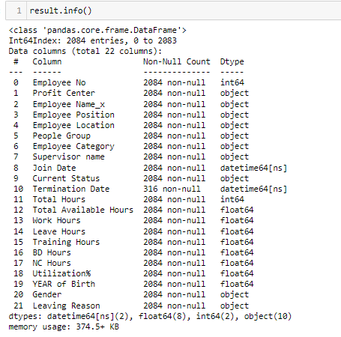
🛠️ Data Preprocessing
🧹 Data Cleaning:
Addressed missing values, duplicates, and noise to enhance data quality.
🔄 Remove Correlated Values:
Eliminated highly correlated features to reduce redundancy.
❌ Error Removal:
Used pivot tables to identify and remove error values from the data.
🔍 Feature Selection:
Removed non-essential columns based on business relevance.

Slide 6
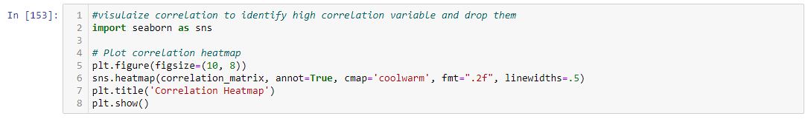
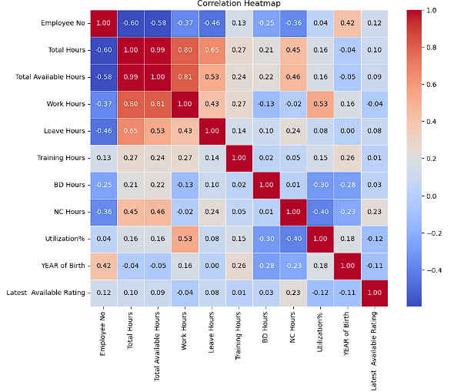
🧩 Exploratory Data Analysis (EDA)
Correlation Heatmap.
High Correlation:
Total Hours & Available Hours (0.99) 🕒: Managing availability closely affects total hours worked, highlighting the importance of optimizing schedules.
Work Hours with Total & Available Hours (0.81) ⏳: Strong link suggests that optimizing work hours can lead to better utilization and overall productivity.
Low Correlation:
Utilization% 📉: Shows weak correlation with other metrics, indicating that utilization might be influenced by factors beyond just hours worked or availability.
Year of Birth 🎂: Minimal impact on time metrics, suggesting age is not a significant factor in determining hours worked or utilization.
Page No 5

Slide 7
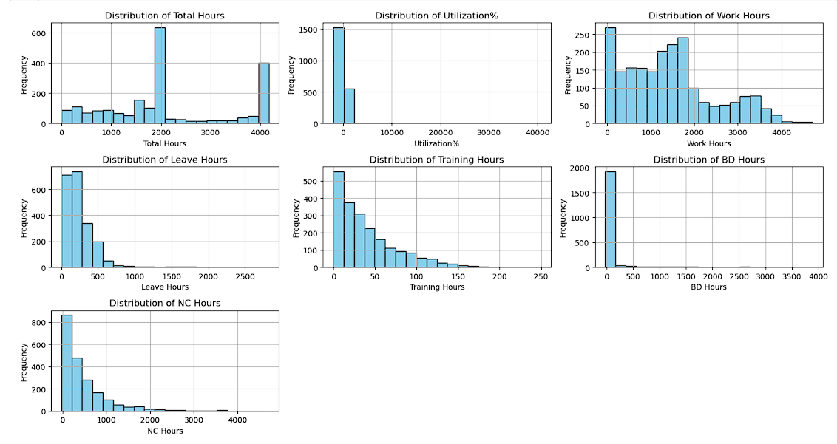
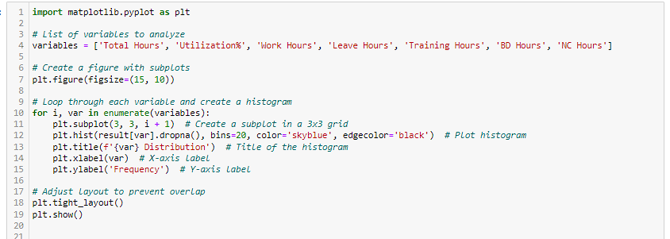
📊 Histogram Analysis:
Total Hours Distribution:
Bimodal Peaks: Two distinct peaks suggest differing employee work patterns. Consider balancing workload distribution. 🕒
Utilization% Distribution:
Heavily Skewed: Most employees have low utilization. Address underutilization to boost efficiency. 📉
Work Hours Distribution:
Normal with Long Tail: Most have similar hours, but a few are overworked. Manage workload to prevent burnout. ⚖️
Leave Hours Distribution:
High at Lower Hours: Minimal leave taken may signal a strong work culture but also potential burnout. Encourage proper leave utilization. 🌴
Training Hours Distribution:
Right-Skewed: Most spend little time on training. Enhance development programs to support growth and retention. 📚
BD Hours Distribution:
Minimal Hours: Low BD hours suggest missed growth opportunities. Promote more focus on business development. 📈
NC Hours Distribution:
Decreasing Trend: Few NC hours could mean underreporting or neglecting non-chargeable activities. Balance chargeable and non-chargeable work. 🔄
Page No 6

Slide 8
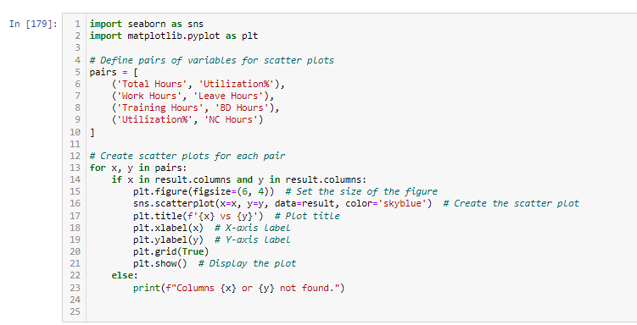
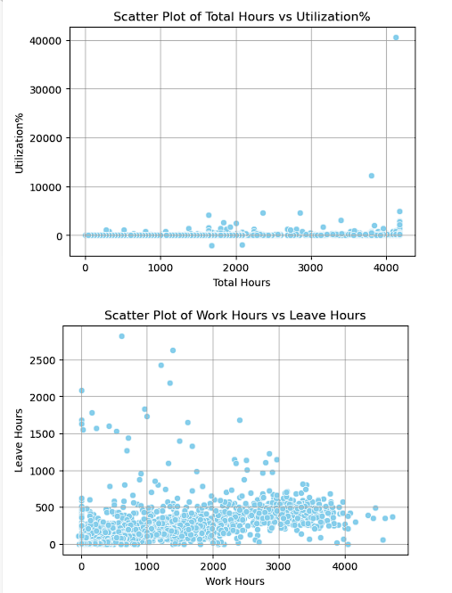
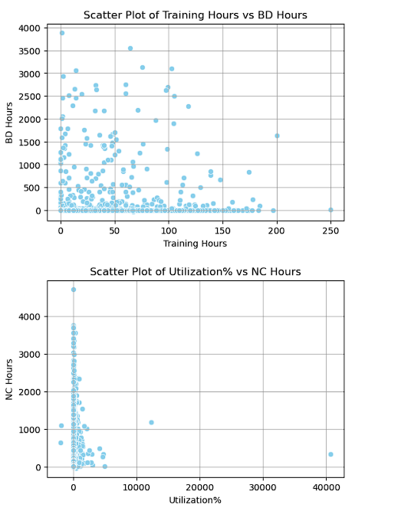
Scatter Plots:
Total Hours vs Utilization% 📈: High total hours do not necessarily mean higher utilization rates. Investigate inefficiencies where time may not be effectively contributing to productivity.
Work Hours vs Leave Hours 🏖️: Lack of strong patterns may suggest variability in work-leave balance. Standardize policies where possible.
Training vs BD Hours 📉📈: Absence of a clear pattern indicates a need for improved integration between training and business development efforts.
Utilization% vs NC Hours 🔄: High non-chargeable hours often correlate with lower utilization rates. Reducing non-chargeable time could enhance overall efficiency.
Page No 7

Slide 9
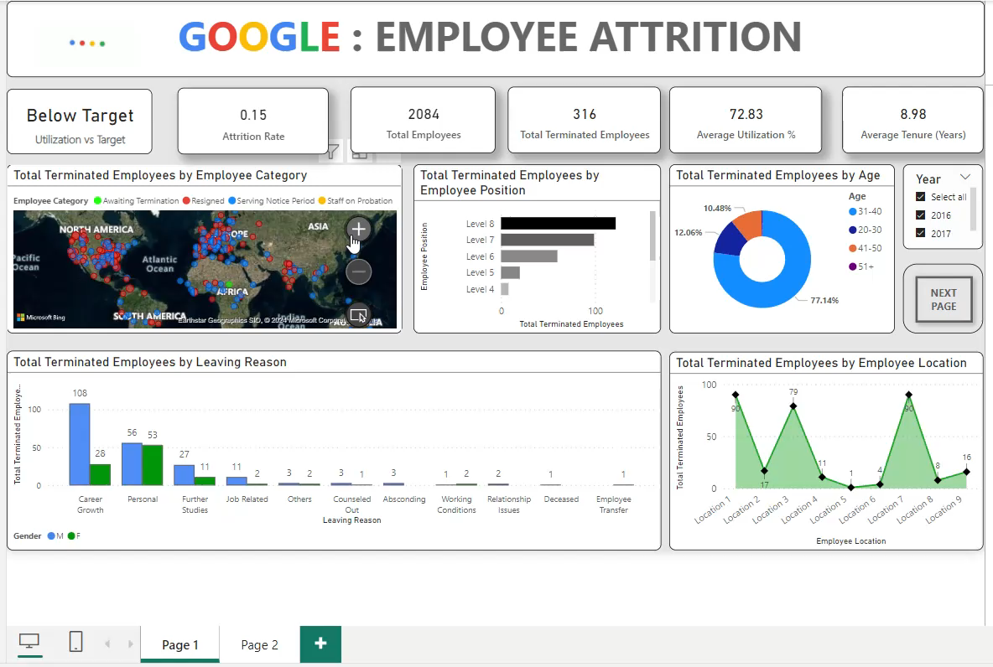

Slide 10
🚀 Insightful Data Perspectives
📊 Utilization & Attrition Metrics
Utilization Rate: 72.83% 📉 – Opportunity to enhance workforce efficiency
Attrition Rate: 0.15 💼 – Key indicator of employee turnover.
Total Employees: 2,084 🧑‍🤝‍🧑 – Insight into workforce size.
Terminations: 316 🚪 – Essential for understanding turnover dynamics
📊 Employee Demographics: Position & Age Analysis
Position-Based Terminations: Higher-level employees (Levels 7 and 8) have a higher termination rate. 📈 This may indicate a need to reevaluate leadership expectations and support.
Age Group Analysis: 77.14% of terminations are among the 31-40 age group. 🎂 Targeted retention strategies could be effective for this mid-career segment.
Strategic Insight: Focus on leadership development and work-life balance initiatives to retain top talent, especially within the mid-career age group. 🎯
🌍 Global Insights: Geographic Distribution
Terminations by Region: The map highlights terminations across key regions—North America, Europe, and Asia—using distinct markers for categories like Resigned, Serving Notice, and Awaiting Termination. 🗺️
Strategic Insight: Use this data to tailor retention strategies, focusing on regions with higher termination rates. 🌐
🔍 Supervisor & Work Hours Correlation
Supervisor Impact: Supervisors such as Hedi Elna and Myrtie Brana have the highest termination rates. 🕵️‍♀️ This may highlight a need for improved supervisory practices.
Work Hours Analysis: The scatter plot shows a link between available work hours and resignation status, indicating potential issues with workload management. ⏳
Strategic Insight: Focus on leadership training and review workload distribution to enhance employee satisfaction and reduce resignations. 🧠
🗺️ Reasons for Leaving & Location-Based Insights
Top Reasons for Leaving: Career Growth is the primary reason for terminations, notably among males with 108 cases. 📈 Personal reasons are the next most common, affecting 56 employees.
Location Analysis: Location 7 has the highest termination rate with 79 employees. This suggests potential issues in management or workplace culture. 🏢
Strategic Insight: Focus on career growth factors and address specific location issues to effectively reduce attrition. 🎯
📊 Profit Centre Analysis
Termination Distribution: Profit Centre 4 has the highest termination count, followed by Profit Centres 1 and 2.
Strategic Insight: Reallocate Resources: Consider redistributing resources or offering additional support to high-attrition centres to stabilize them and reduce turnover.
Page No 11

Slide 11
🌟 Comprehensive Business Strategies for Workforce Optimization 🌟
Optimize Resource Allocation 🚀
Maximize Utilization: Align workload distribution with employee strengths and capacities to ensure maximum efficiency and productivity. 🔄
Engage Low Performers: Identify underperforming teams or individuals and provide them with targeted support or training to elevate their performance. 📈
4. Address Regional Discrepancies 🌍
Targeted Regional Support: Tailor management practices and resources to the unique needs of each region, especially in high-attrition areas like Location 7. 🌐
Regional Leadership Reviews: Conduct regular assessments of local leadership in regions with high attrition and make necessary adjustments to enhance management effectiveness. 🔄
2. Enhance Leadership Practices 🧠
Leadership Audits: Regularly evaluate leadership practices, especially at senior levels (Level 7 and 8), to ensure effective management and team support. 🕵️‍♂️
Mentorship Programs: Implement robust mentorship and leadership development programs to prepare mid-level employees (Levels 6 and 7) for higher roles, reducing turnover in critical positions. 👩‍🏫
5. Develop Customized Retention Programs 🎯
Gender-Specific Strategies: Design retention programs that cater to the diverse needs of male and female employees. For instance, offer flexible work arrangements for women and more aggressive career development programs for men. 🌈
Holistic Support Systems: Implement comprehensive support systems that address both career and personal needs, such as mentorship programs, wellness initiatives, and flexible working conditions. 🧘‍♀️
3. Focus on Mid-Career Development 🌱
Career Path Clarity: Provide transparent career progression paths and growth opportunities, particularly for employees in the 31-40 age group, to prevent them from seeking opportunities elsewhere. 🎯
Mid-Career Programs: Offer specialized programs to rejuvenate enthusiasm among mid-career employees, aligning their goals with the company’s vision. 🌟
6. Conduct Operational Audits and Resource Reallocation 🔍
Profit Centre Audits: Perform in-depth operational audits of high-attrition profit centres (e.g., Profit Centre 4) to identify and resolve underlying issues like workload distribution, employee satisfaction, or leadership effectiveness. 📊
Resource Redistribution: Reallocate resources or provide additional support to stabilize high-attrition centre, thereby reducing turnover and enhancing operational efficiency. 💼
Page No 12

Slide 12
🏆 Conclusion: Optimizing Employee Retention with Python & Power BI
Project Summary:
This project harnesses Python and Power BI to effectively tackle the challenge of employee attrition by providing comprehensive, actionable insights.
Key Achievements:
Advanced Analysis: Python enables detailed data exploration and predictive modelling to identify factors contributing to attrition.
Clear Visualization: Power BI transforms complex data into intuitive dashboards, highlighting key metrics and trends.
Targeted Strategies: Insights from both Python and Power BI facilitate the development of specific, data-driven strategies to address high attrition areas and enhance employee retention.
Outcome: By integrating sophisticated data analysis with dynamic visualization, this project empowers the organization to make informed decisions, optimize workforce management, and ultimately reduce employee turnover

Slide 13


